Slide 1

Fading Footprints
Soul Searchers - Aashay Zanpure, Ariz Shaikh, Bharath Sreekumar, Kangcheng Su, Krupa Nilesh Shah, NVS Dhanushree, Palak Bharatkumar Tandel, Ritesh Pachgade

Slide 2

Problem Statement
To investigate migrant incidents and uncover global patterns and dangerous routes, amplifying the stories of missing migrants to influence global migration policies.

Slide 3

Data Processing
Data Retrieval
Dataset from IOM
13360 records
25 variables
Filtering and Cleanup
Addressed missing values
Categorized Cause of Death
Outlier Detection and Removal

Slide 4

Data Analysis
Where did they go missing?
What are the reasons for migration?
Can we predict the migration incidents for the near future?

Slide 5

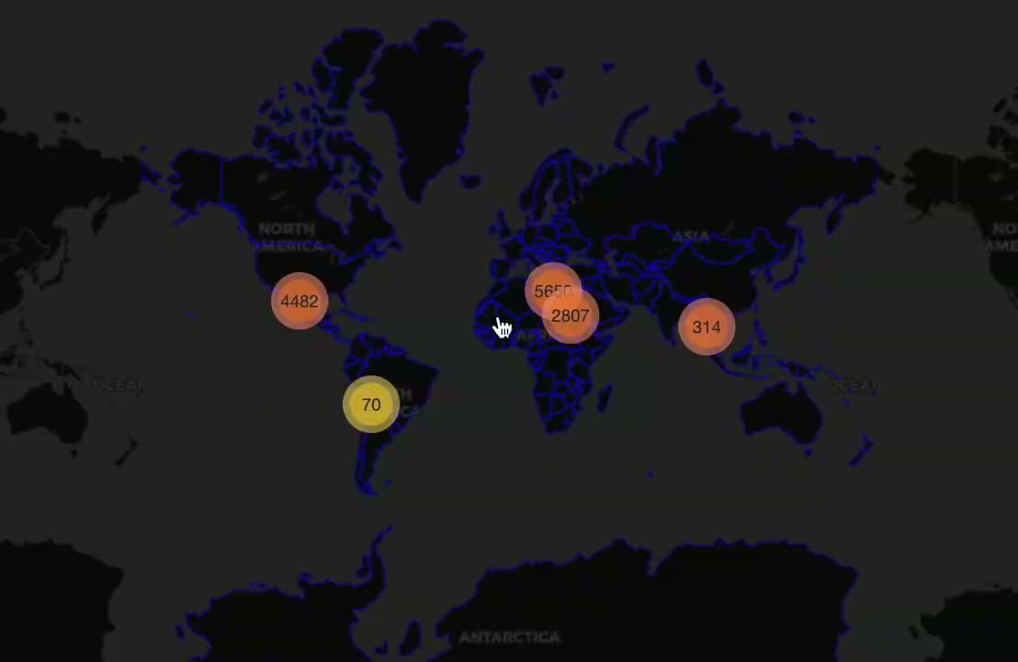
Where did they go missing?

Slide 6
Analysis
Patterns in Incident Locations
Migration Routes and Risky Terrains
Geopolitical Impact
Humanitarian Crisis
Importance of Data Collection
Socio-Political Challenges

Slide 7

What are the reasons for migration? (Economic factors)
Number of Incidents | Country | GDP Growth Rate (%) | GDP Per Capita ($) | Inflation Rate (%) | Unemployment Rate (%)
260 | Afghanistan | -20.70 | 426.0 | -8.10 | 13.3
112 | Mexico | 3.30 | 9756.0 | 4.26 | 2.9
54 | Guatemala | 3.85 | 4504.0 | 4.98 | 3.0

Slide 8
What are the reasons for migration? (Non-economic factors)
Family Reunification
Cultural and Social Elements
Climate Change
Natural Disasters
Human Rights Concerns
Insecurity and Violence
High Crime and Lawlessness

Slide 9

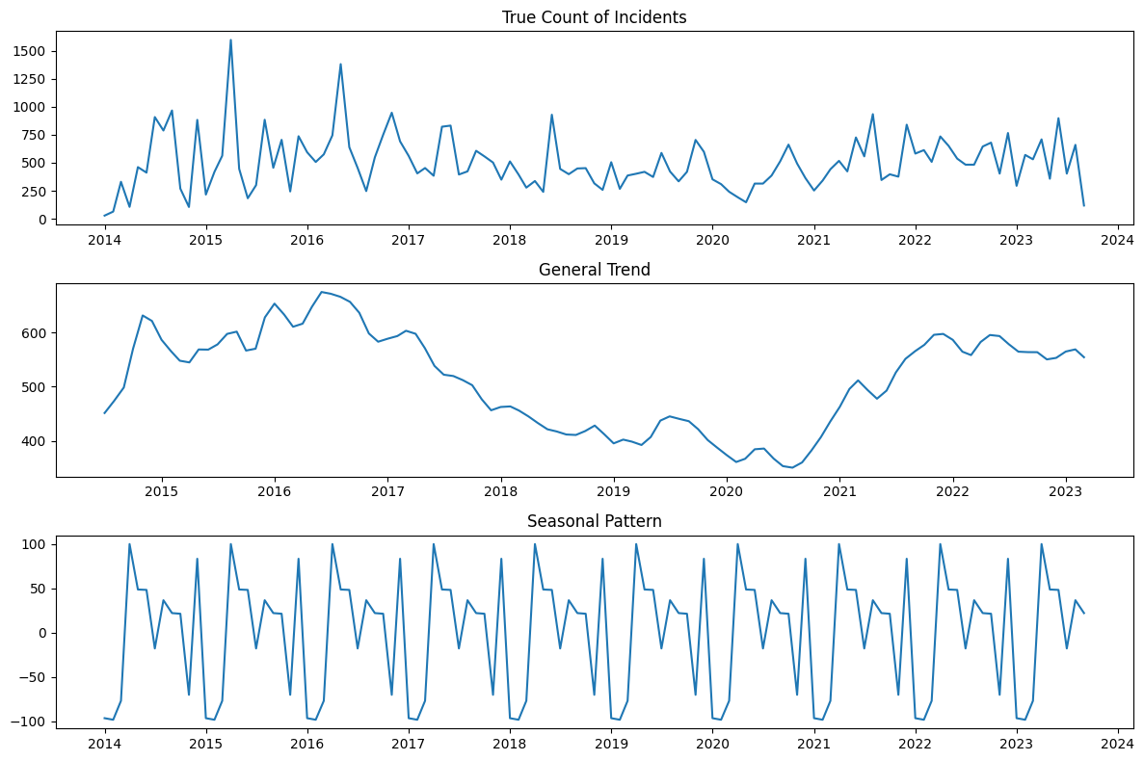
Predicting the Number of Migrant Incidents for the Next Season
Is there a general trend?
Is there a seasonal pattern?

Slide 10
Predicting the Number of Migrant Incidents for the Next Season
Month | Predicted Immigrants
Oct-2023 | 634
Nov-2023 | 329
Dec-2023 | 481
Jan-2024 | 495
Feb-2024 | 397
Major reasons for migration:
Start of Winter in October
Thanksgiving in November
Christmas and New Year’s in December
And similar reasons throughout the entire seasonal pattern

Slide 11

CONCLUSION
Unveiled hidden migrant stories and established the groundwork for responsive policy.
Enhanced predictive models and integrating inclusive technological solutions stand as promising pathways.
Future Scope: Leverage advanced analytics to expand partnerships and empower proactive responses along with deeper insights into global migration challenges.

